Slide 1
Business Case for TechnoTrends App
4 February 2015

Slide 2
Where does Our University stand in offering its own mobile app/framework to our learners?
Last year, Our University was faced with an important question from the business more than once - Are we ready to provide mobile access to all our learners?
With this several other questions came up:
Do we create the app for a specific course or is it to be an overarching OU app?
What would be the cost to create such an app?
Do we have the skills to do so?
How do we maintain this app?
What are the features the app should have – offline access, downloadable content, push content etc.
Through this Business Case document, we would like to present to ExCom a point of view on the above questions and get a decision on the way forward.

Slide 3
Key points/feedback gathered from the Group Kick-off. We observed that Vice Presidents:
Were not seen using laptops. They pre-dominantly used Mobile phones, some used tablets.
Didn’t find the Virtual Campus mobile app easy to use – especially the first time users.
Loved the Lexicon, some had already downloaded it before hand.
Were happy to see that they could access the content (Lexicon) offline. Many of them downloaded the PDF to their iBooks on their tablet.
Wanted to share the Lexicon with their clients.
Considering all of the above, the virtual campus mobile app doesn’t seem to be the way to move forward for VPs.

Slide 4
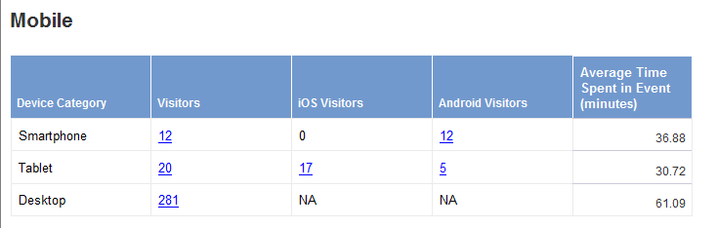
The feedback was not positive when the Virtual Campus mobile app was used for Digital University
2 out of these 5 were OU members
7 out of these 17 were OU members
Feedback from Learners:
Didn’t like not being able to view from iPhone (only iPad and all Android).
Don’t like the number of clicks to go from the app to the virtual campus - login is pretty cumbersome, especially the first time.
Liked not having to be on the Capgemini intranet to view some of the learning.
Definitely liked having the app display on their tablet for easy-to-find access.

Slide 5
A custom app for TechnoTrends will present several benefits to the business and learner
Access to content without internet connectivity – The app does not need internet access after the initial login.
Suits a highly mobile and busy target audience – VPs are on the move and need information at their finger tips.
Easy, low cost maintenance and authoring – The content can be updated from backend easily.
Simple and user friendly design – The app allows simple navigation to the content and is easy to use.
Push Notifications – The user receives push notifications on the app for any content updated and announcements.
Media friendly- The app will allow the media elements (audio / video) to play seamlessly once downloaded.
Branding – The app/icon and the content will be customized and branded as per Capgemini branding guidelines/TechnoTrends branding

Slide 6
Total of Cost of Ownership of the custom app created by the mobility team is:
Particulars | One time/Recurring | Cost | Comments
Mobility Team Development Cost | One-time | € 38858 | 413 Total person days
Mobility Support Cost 1 consultant 100% for 3 months | One-time | € 3000 | EUR 69 X 63 days
Hosting AWS setup (USD $3408) | Recurring | € 3000
AWS (USD $183/ month) | Recurring | € 1860 | EUR 155 X 12
Deployment (Airwatch) 1500 VPs + 100 extra licenses | Recurring | € 48384 | € 2.52/User/Month (2.52 X1600) X12
First year costs (One time cost + Other costs) = € 41858 + € 53244 = € 95102
Second year onwards (Annual recurring cost) = € 53244

Slide 7
The Our University can create the app solution for all platforms
Total Development & Testing efforts for Year 1 – 140 days
Total Maintenance for Year 2 (and onwards) – 30 days
What we can’t manage if we create the app by ourselves:
Features | Importance | Impact
Integrate with Corporate Directory | Medium | Need to manually manage users – new, leaving organisation Corp credentials cannot be used by participants.
Managing the app using Air Watch | Low | When users leave the organisation, we cannot delete the user’s app data.
Build Content rating system | Medium | User rating and user generated content wont be available.

Slide 8
Cost Comparison – total cost of ownership of development of app by either teams
Team | Mobility team | Our University
First Year Costs (One time cost + Other costs) | € 95102 | € 24500
2nd Year Onwards Costs (Annual Recurring Costs) | € 53244 | € 5250
Please note:
Any new features or changes or updates to the App (after deployment) will need to be estimated separately.
It is assumed that the content to be uploaded is already existing in the Virtual Campus. It doesn’t include effort for creating new/additional content.

Slide 9
Comparison of features if app developed by Mobility team versus OU team
S.no. | Features | Mobility Team Build | NGL D& I Build
1 | Existing iShowcase Framework
2 | Ratings
3 | Android/IOS (Online/Offline) and Desktop Browser (Online)
4 | Involvement of Testing Practice
5 | AIR Watch Integration
6 | Corporate Directory Integration
7 | User authentication
8 | Offline content Access
9 | Content Management System
10 | Push Notification
11 | User Management
12 | Track User reports (Mobile type, Access data)
13 | Quiz
14 | Track User score
15 | Video/Audio offline/online
16 | Update and sync content
17 | Archive content on Delete
18 | Browser support IE9+, Safari and Chrome

Slide 10
Comparison of Virtual Campus Versus Custom App created by Our University
Features | Virtual Campus | Custom App
Supporting Device | iOS, Android, Desktop | iOS, Android, Windows, Desktop
Offline Access | No | Yes
Security | Yes, Limited | Can be secured with Corp SSL (mobility team)
Push notifications | No | Yes
Manage Downloads | Yes (Briefcase) | Yes
CMS | Yes | Yes
Tracking | Yes, User Analytics report | Yes, limited
Mark Favorites | No | Yes
Media playback | Yes, online media playback only. | Yes, can be integrated in between of content page. Downloadable for offline view.
Customization | Limited. Some dependencies on vendor | Fully customizable. Dependencies on internal team.
Responsive Design | Yes, limited | Yes

Slide 11
The iShowcase app created by the Group Sales team can also be an option to host the TechnoTrends content
iShowcase is an app for external facing communities in Capgemini and hosts Sales specific content only
Benefits of the iShowcase app
The app is already available – so the app will not cost us anything to build (content will still need to be built).
Content replacement is done by the iShowcase team , so University Ops will not be involved in maintenance of content.
3. TechnoTrends content (PDFs, Videos) can be directly housed on iShowcase.
Areas where we could face roadblocks
The iShowcase app has a lot of ‘sales/ corporate’ content. The Technotrends content may not stand out.
First time download of the app (4GB of data) requires approximately 30 minutes to sync.
3. The iShowcase app can be accessed only on tablets and not on desktops and smartphones.

Slide 12
Another option to create this app is to use FS’s TeamX platform
The TeamX platform is a crowd-sourcing platform that uses pools of resources on bench to develop projects
Benefits of using TeamX to create the TechnoTrends App
Uses the power of the crowds to build the app.
Is free to use as it pulls people on bench.
3. Is gamified, which means developers on the project are highly motivated.
Areas where we could face roadblocks
The platform has been used till date only for very small projects – for example process optimization.
The TechnoTrends app is meant for the CTO community so we definitely need an expert team to work on the Technical complexity and Usability aspect of the app.
Reviewing and managing the skills may be challenging for Our University.

Slide 13
Annexure Slides

Slide 14
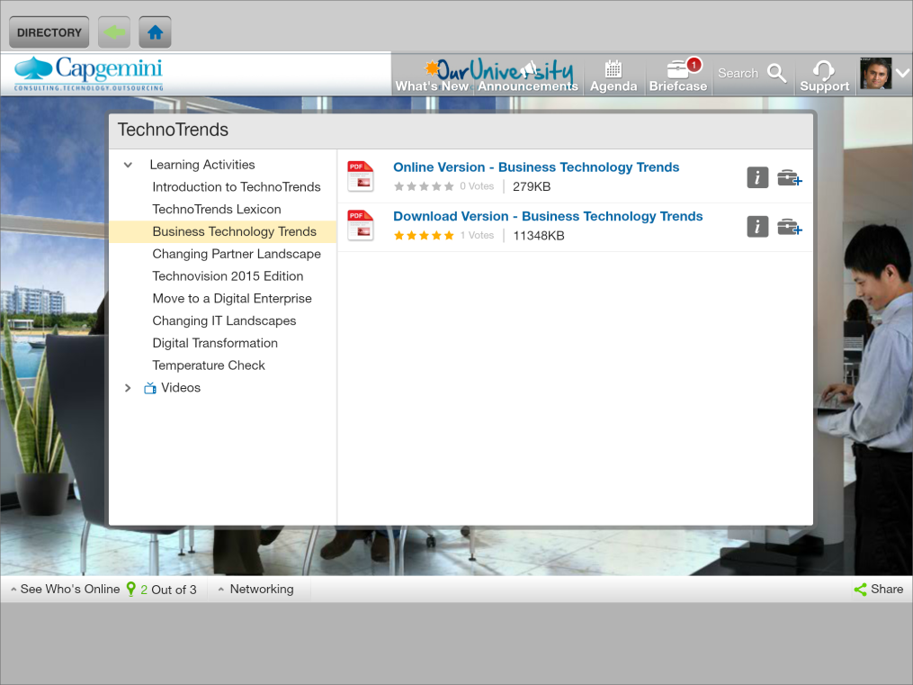
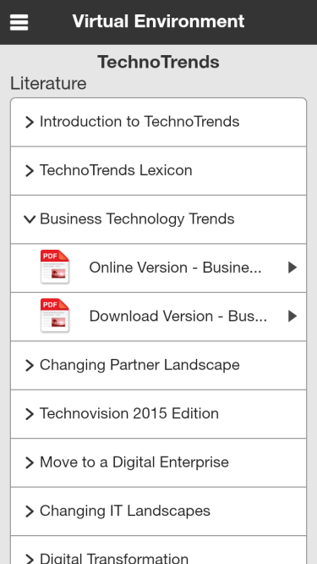
Virtual Campus
The videos and contents cannot be combined – They are placed in separate sections

Slide 15
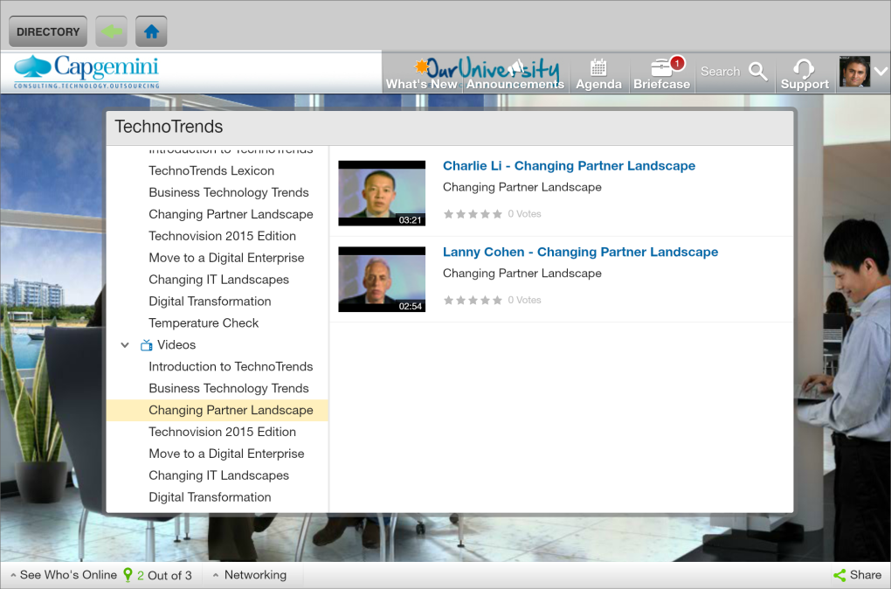
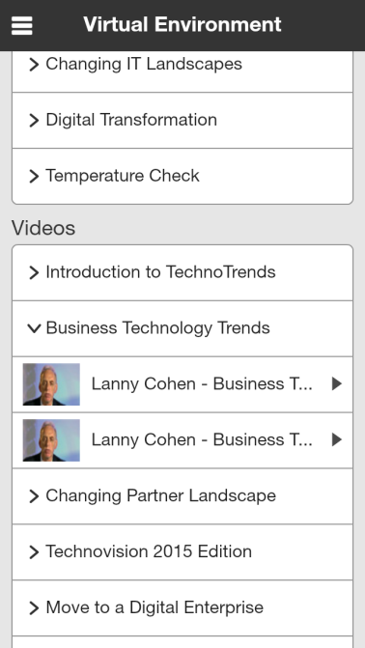
Virtual Campus
The Videos are played individually in pop-up window, one at a time.

Slide 16
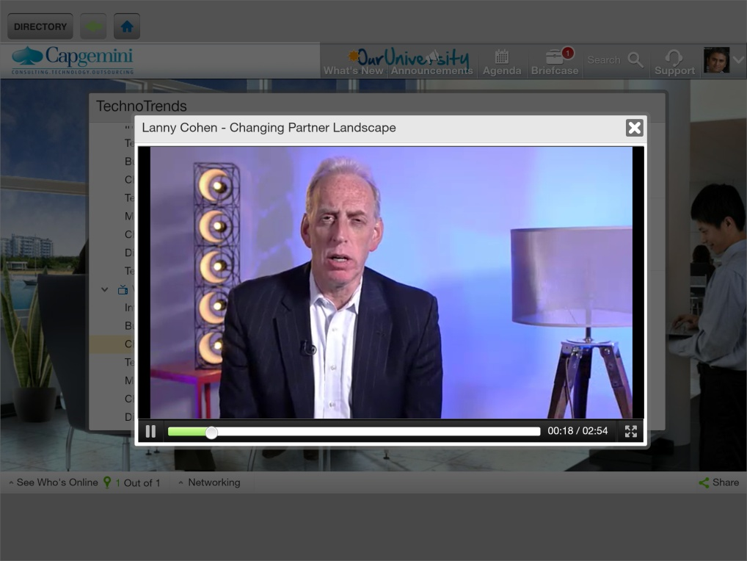
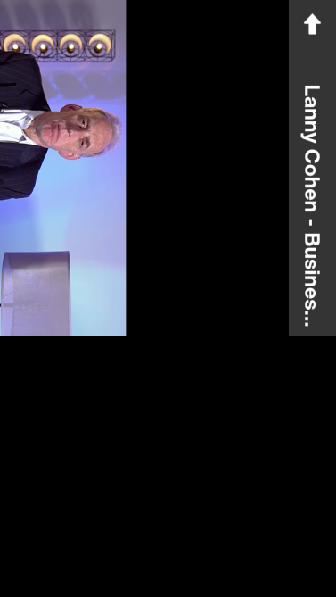
Virtual Campus
The Virtual Campus mobile app doesn’t work well if the device’s orientation changes

